Slide 1
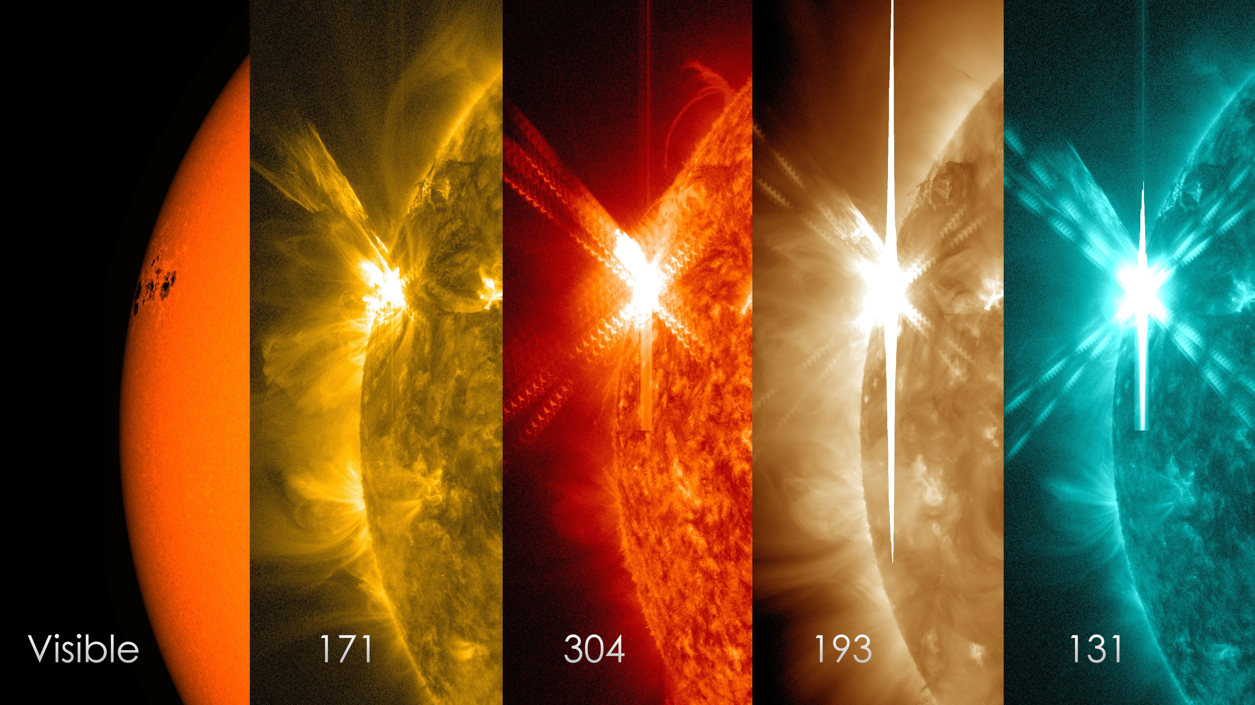
Simulating Shocks in Solar Flares
Matthew Thornton Supervisor: Dana Longcope
NASA/SDO/S. Wiessinger
Notes:
Going to talk about solar flares
The flare modelling I’ve been doing
A couple of the things I’ve found
The public like them too
Eg. Border guard in Seattle, flare that killed the dinosaurs

Slide 2
Reconnection and flares
10²³ – 10²⁵ Joules released in 10¹ – 10³ seconds
Powered through reconnection
Active regions heated to tens of megakelvin
Plasma heated and accelerated -> flares observed in radio, soft/hard xrays, EUV
Lang (2001)
http://ase.tufts.edu/cosmos/print_images.asp?id=47
Notes:
Talk through the things on the slide
Loop. Massive energy release at the top. Electrons accelerated – radio waves released and hard xrays
Electrons channelled down the loop at nearly the speed of light. Hard xrays at the loop footpoints.
Electrons reach the chromosphere – nuclear reactions -> gamma rays.
Evaporation. Slow gradual increase in soft x-ray emission.
Really interesting from the point of view of a theoretician
Lots of non-ideal competing processes and complex topology

Slide 3
“…reconnection is essentially a topological restructuring of a magnetic field caused by a change in the connectivity of its field lines.” (Priest & Forbes, 2000)
Project simulates flare energy release due to reconnection
Magnetic energy
$$W_{B}= \int{\frac{B^{2}}{2 μ_{0}}}dV$$
$$= \int{dφ}\left(\frac{1}{2μ_{0}}\int{B dl}\right)$$
Kinetic energy
Thermal energy
Longcope & Klimchuk 2015 (submitted)
Notes:
Most of the universe is plasma and magnetic fields
Reconnection is a hugely important process!
Eg. Reconnection occurs in:
Solar atmosphere
Earth’s magnetosphere
Can do it in the lab too
Talk about my project.
Simulating flare energy release due to reconnection and retraction.
Talk about figure:
Sheared magnetic field. Current sheet.
Flux tube confined within the current sheet. B field constant along the tube
Reconnection between points b and c.
Now the flux tube can release energy by shortening (refer to equation)
Magnetic energy -> kinetic energy (by Lorentz force) -> thermal energy (because of shocks in the plasma)
In my project I’m simulating what happens after reconnection using PREFT (post-reconnection evolution of a flux-tube). Specifically:
Trying to quantify how the initial conditions (shape, length, field strength, etc.) affect the resulting temperature, density etc. profiles of the shocked plasma
Also looking at how energy distributes itself in the plasma, and how initial conditions affect this
Placed an emphasis in the last month or so on looking at the peak flare temperature
- In PREFT we assume that reconnection has already taken place, then look at the retraction of a single 1D flux tube
- Simulates the dynamical equations governing the field line retraction after reconnection (next slide)

Slide 4
PREFT solves the mhd energy and momentum equations for a given fluid element
$$c_{v}ρ\frac{dT}{dt}=−p\left(\underline{\hat{l}} . \frac{∂\overset{⃑}{v}}{∂l} − \frac{∂logB}{dt}\right)+B \frac{∂}{∂l}\left(\frac{κ}{B}\frac{∂T}{∂l}\right)$$
$−{n_{e}}^{2}Λ\left(T\right)+ \frac{4}{3}μ{\left(\hat{\underline{l}} . \frac{∂\overset{⃑}{v}}{∂l}\right)}^{2}+H(l,t)$
Energy:
$$ρ \frac{d \vec{v}}{dt}= \left(\frac{B^{2}}{4 π} −p\right)\frac{∂\hat{\underline{l}}}{∂l} − \left(1+ \frac{4πp}{B^{2}}\right)∇_{⊥}\left(\frac{B^{2}}{8π}\right)− \hat{\underline{l}}\frac{∂p}{∂l}+ ρ\overset{⃑}{g}$$
Momentum:
$$+ \frac{4}{3}B \frac{∂}{∂l}\left[\hat{\underline{l}}\frac{μ}{B}\left(\hat{\underline{l}} . \frac{∂\overset{⃑}{v}}{∂l}\right)\right]$$
Notes:
Talk about individual terms in these equations and their importance.
(note: going to talk about thermal conductivity on a later slide)
Energy equation
Adiabatic work – energy input due to change in volume
Divergence of the heat flux – heat flux follows magnetic field lines. Thermal conductivity along fieldlines is much (much) larger (~10 orders of magnitude) than the conductivity transverse to the field lines
Means that 1D flux tube modelling is a good idea
Radiative losses
Viscous heating – necessary to include a viscosity term due to the shocks. It’s this term which heats the plasma
Ad hoc source – everything else! Things we don’t yet understand
Momentum equation
Momentum equation is analogous to Newton’s second law. LHS – mass times acceleration
RHS – forces acting on the plasma
First term on RHS – force due to the magnetic tension. Straightens the tube
Magnetic tension force – doesn’t like curvature in the B field. Tries to straighten it. Converts magnetic energy to kinetic energy.

Slide 5
WE simulate what occurs after reconnection
Bend angle 90deg
B = 75G
L = 74Mm
$$ξ^{−1}=0.0$$
Notes:
Remember to talk about what each individual graph is showing.
PREFT simulates what happens to an individual flux tube after reconnection.
Focus on the rhs graph first
RHS graph
Post – reconnection, the magnetic field lines retract and heat the plasma to tens of megakelvin
Magnetic tension force changes the shape of the flux tube. Analogous to tension in an elastic band
Our initial 90degree bend splits into two 45 degree bends
RD’s moving outward at the Alfven speed
Bend is NOT in the middle of the tube – more realistic scenario
We artificially straighten the tube when it hits the corona and continue evolving energy and momentum equations.
LHS graph
Explain what we’re looking at here:
x axis is l -> our position along the flux tube
Bend at ~30Mm
Showing only the left half of the flux tube. Analogous things happening on the rhs.
Chromosphere on the left
Run the gif once.
Velocity parallel to the flux tube -> material rushing in to 30Mm (where the bend originally was) -> increase in density around this region (look at ne graph)
Thermal and pressure fronts form and propagate along the flux tube faster than the Alfven speed

Slide 6
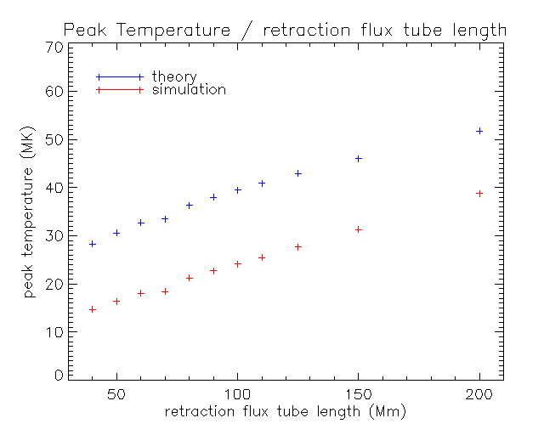
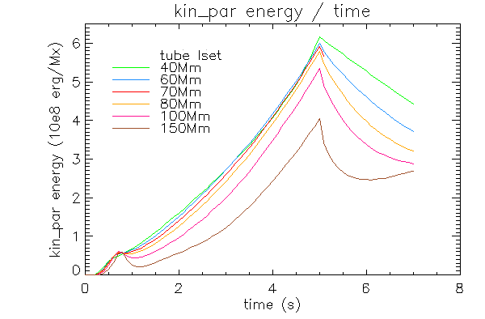
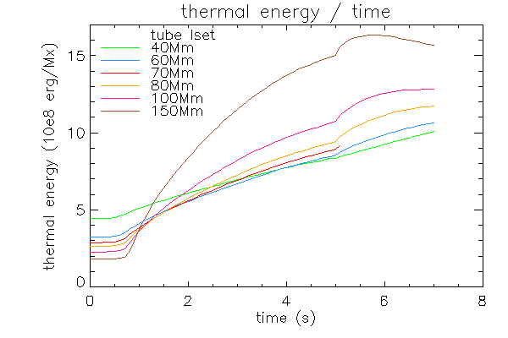
Increasing L increases thermal energy
$$T_{fl} ∝ B^{6/7}L^{2/7}n_{e}^{−1/7}{Sin}^{8/7}\left(\frac{∆θ}{4}\right)$$
Notes:
Talk about first two graphs.
- Explain what we’re actually looking at.
Tube straightened at t = 5s.
Bump in kin_par graph -> kinetic energy starts turning into thermal energy
Longer flux tube – way better at thermalizing energy.
Begins with initially less thermal energy (in the simulations, I think the total mass of the tube was kept the same so density decreases).
Third graph – peak temperature / retraction flux tube length
v. useful to know the peak temperature of the flare. It’s something which can actually be measured, unlike, say, the bend angle.
Dana calculation of the peak flare temperature. Depends on B, L, theta. (INCLUDE FORMULA)

Slide 7
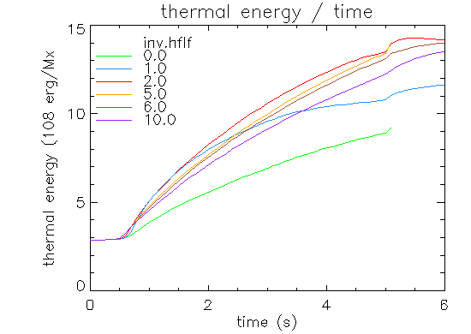
Too much heat flux
$κ={κ_{sp}\left[1+{\left(ξ^{−1}\frac{κ_{sp} \left|\left.∂T/∂l\right|\right.}{F_{fs}}\right)}^{2} \right]}^{−1/2}$
Excessively large heat flux motivates the introduction of a limiter: ξ
$$F ∝−κ ∇T$$
$$with spitzer conductivity κ= κ_{0}T^{5/2}$$
Notes:
(Note: F here is actually the heat flux density)
Thermal conduction coefficient: spritzer conductivity (I think it’s usually quoted as the Spitzer resistivity)
Problematic and unphysical when temperature gradients become too large. “Heat flux would exceed the amount carried by thermal electrons if they just streamed freely along the tube.”
Motivates the introduction of a limiter -> introduce inv.xi!
Modified thermal conductivity. Increase inv.xi -> decrease k. inv.xi = 0.0 (xi = infinity) is the classical / non-limited case.
This parameter has some very interesting physical influence on the flux tube evolution. Eg. Look at gif:
When the gif appears, tell people what this is a movie of.
Play gif till about half way through and tell people what we’re seeing.
- inv.hflf is xi^-1
- steepening of temperature fronts with inv.hflf
- increasing of peakT with inv.hflf.
Makes sense, since we’re stopping the heat from moving efficiently.
RHS graph: inv.xi affects how energy is thermalized. System is best at converting kinetic energy into thermal energy around inv.xi = 2.0 (actually 2.5).
It’d be interesting to see why this is. Also it’d be interesting to see the output from PREFT if we set inv.xi to, say, 100. (perhaps unphysical). It seems like (from the next slide) that peakT should keep on increasing

Slide 8
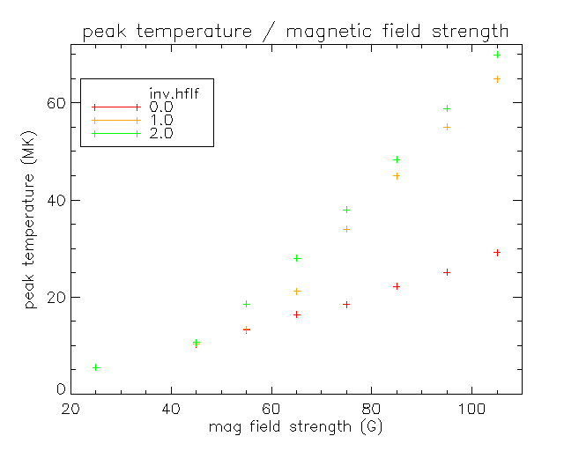
Increasing $ξ^{−1}$ increases peak temperatures
Previously:
$$T_{fl} ∝ B^{6/7}L^{2/7}n_{e}^{−1/7}{Sin}^{8/7}\left(\frac{∆θ}{4}\right)$$
- Only works for ξ⁻¹ = 0.0.
Notes:
Spent a lot of time looking at the peak flare temperatures and how they vary with the initial conditions.
Why? Because we can measure Tpeak. Can’t measure, say, bend angle.
Remember to explain each term in the expression for Tpeak.
Explain graph:
Makes sense that increasing L will increase peak Temperature – ΔL is greater so more energy released into the plasma.
We saw in the previous gif that increasing inv.hflf increases peak temperature.

Slide 9
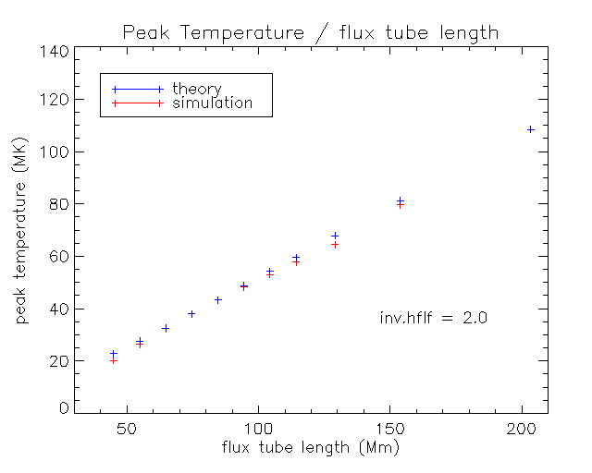
Peak temperatures when $ξ^{−1}≠0.$
New expression:
$$T_{fl} ∝{\left(\frac{B^{3}}{\sqrt{{ρ_{min}}^{3}}} {Sin}^{4}\left(\frac{∆θ}{4}−0.1\right)\right)}^{\frac{2}{3}}$$
$×{\left(ξ^{−1}\right)}^{1/7}$
Notes:
Previous expression only works for inv.xi = 0.0. It’d be nice to be able to predict the peak flare temperature for inv.xi =/= 0
Spent lots of time curvefitting in Mathematica and IDL.
Found how things vary with B and rhomin and theta. But fit wasn’t quite right.
Read Fisher, 1989, who suggested a form for Tpeak in terms of heat flux F and preflare coronal density.
Dimensions work. When I include the constants (me, mp, kb, etc.) in the above formula the dimensions work out and it predicts the ballpark of the temperature. If I (arbitrarily) multiply the expression by 1.8 then I get a good fit across the board.
Talk about graph – just one of many graphs I could show demonstrating the fit.
Range of values tested where this expression is good:
B (25,150)
L (40, 200)
Theta (30, 120)
Inv.xi (1, 6) (works best around 3)
In the future – it’d be nice to understand the physics behind this empirical expression. Could tweak the powers a little bit to give a slightly better fit. Eg. I have no idea physically how we’d even get a phase shift in the sinusoid. Without it, we need to change the constant out the front of the expression, and we only get a good fit for theta <= ~90 degrees.

Slide 10
References
Fisher, G. (1989). Dynamics of Flare-Driven Chromospheric Condensations, ApJ 346, 1019-1029
Lang, K. R. (2001). The Cambridge Encylcopedia of the Sun. Cambridge: Cambridge University Press.
Longcope, D., & Klimchuk. (2015 ). How gas-dynamic flare models powered by Petshek reconnection differ from those with ad hoc energy sources. (Submitted).
Priest, E., & Forbes, T. (2000). Magnetic Reconnection: MHD Theory and Applications. Cambridge: Cambridge University Press.
Weissinger, S. (2015, Aug 03). NASA's SDO Observes 'Cinco De Mayo' Solar Flare. Retrieved from NASA - SDO Solar Mission: http://www.nasa.gov/feature/goddard/nasas-sdo-observes-cinco-de-mayo- solar-flare
Notes:
Any questions?

